Slide 1
Gauss Law

Slide 2
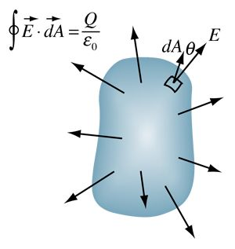
Gauss Law due to infinite sheet of charge :
The Gauss's Law due to an infinite sheet of charge is a specific application of Gauss's Law for electricity.

